Slide 1
BootStrap Unit-5 Part2
How to Create, Edit, & Make a Navbar in Bootstrap

Slide 2
Navigation Bars A navigation bar is a navigation header that is placed at the top of the page:
With Bootstrap, a navigation bar can extend or collapse, depending on the screen size.
A standard navigation bar is created with <nav class="navbar navbar-default">.
WebSiteName Home Page 1 Page 2 Page 3

Slide 3
The following example shows how to add a navigation bar to the top of the page:
<!DOCTYPE html>
<html lang="en">
<head>
<title>Bootstrap Example</title>
<meta charset="utf-8">
<meta name="viewport" content="width=device-width, initial-scale=1">
<link rel="stylesheet" href="https://maxcdn.bootstrapcdn.com/bootstrap/3.4.1/css/bootstrap.min.css">
<script src="https://ajax.googleapis.com/ajax/libs/jquery/3.6.4/jquery.min.js"></script>
<script src="https://maxcdn.bootstrapcdn.com/bootstrap/3.4.1/js/bootstrap.min.js"></script>
</head>
<body>
<nav class="navbar navbar-default">
<div class="container-fluid">
<div class="navbar-header">
<a class="navbar-brand" href="#">WebSiteName</a>
</div>
<ul class="nav navbar-nav">
<li class="active"><a href="#">Home</a></li>
<li><a href="#">Page 1</a></li>
<li><a href="#">Page 2</a></li>
<li><a href="#">Page 3</a></li>
</ul>
</div>
</nav>
<div class="container">
<h3>Basic Navbar Example</h3>
<p>A navigation bar is a navigation header that is placed at the top of the page.</p>
</div>
</body>
</html>

Slide 4
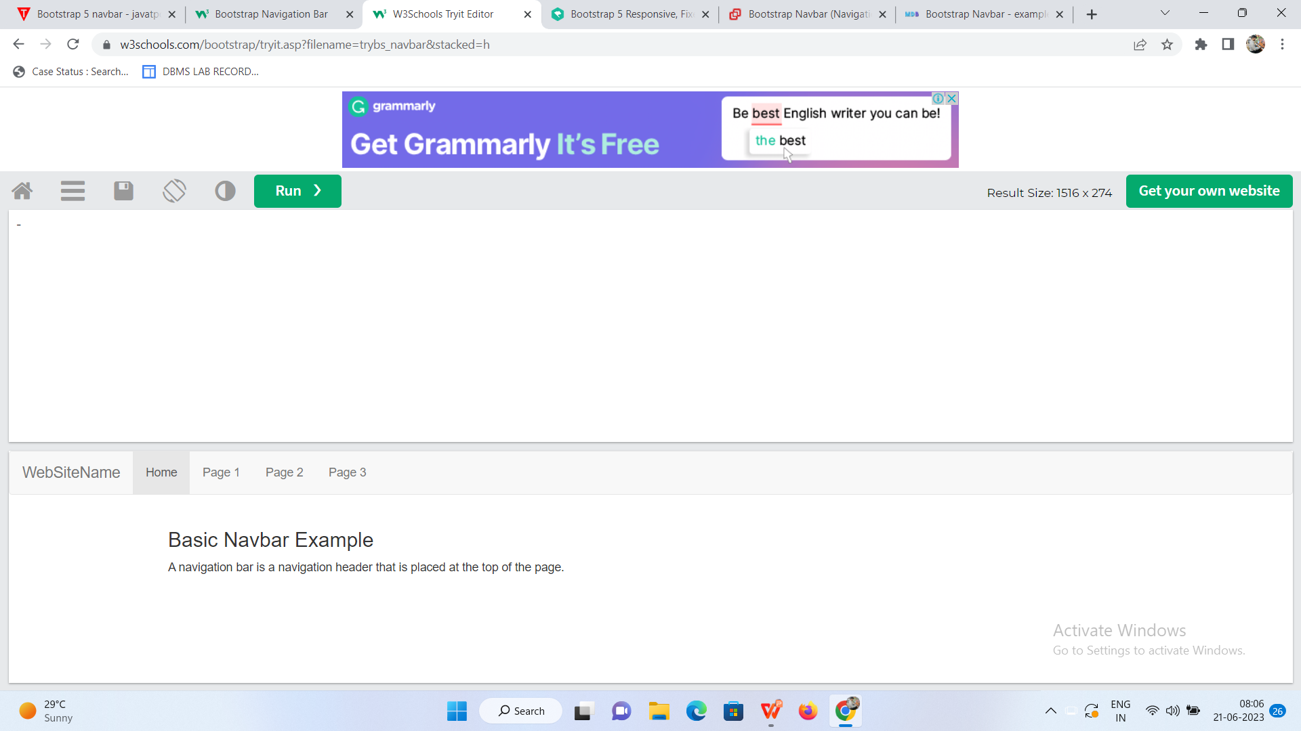

Slide 5
Navigation Bar With Dropdown Navigation bars can also hold dropdown menus.
<!DOCTYPE html> <html lang="en"> <head> <title>Bootstrap Example</title> <meta charset="utf-8"> <meta name="viewport" content="width=device-width, initial-scale=1"> <link rel="stylesheet" href="https://maxcdn.bootstrapcdn.com/bootstrap/3.4.1/css/bootstrap.min.css"> <script src="https://ajax.googleapis.com/ajax/libs/jquery/3.6.4/jquery.min.js"></script> <script src="https://maxcdn.bootstrapcdn.com/bootstrap/3.4.1/js/bootstrap.min.js"></script> </head> <body> <nav class="navbar navbar-inverse"> <div class="container-fluid"> <div class="navbar-header"> <a class="navbar-brand" href="#">WebSiteName</a> </div> | <ul class="nav navbar-nav"> <li class="active"><a href="#">RGUKT</a></li> <li class="dropdown"><a class="dropdown-toggle" data-toggle="dropdown" href="#">SRIKAKULAM<span class="caret"></span></a> <ul class="dropdown-menu"> <li><a href="#">CSE</a></li> <li><a href="#">ECE</a></li> <li><a href="#">CIVIL</a></li> </ul> </li> <li><a href="#">NUZVID</a></li> <li><a href="#">RK VALLEY</a></li> </ul> </div> </nav> <div class="container"> <h3>Navbar With Dropdown</h3> <p>This example adds a dropdown menu for the "Page 1" button in the navigation bar.</p> </div> </body> </html>

Slide 6
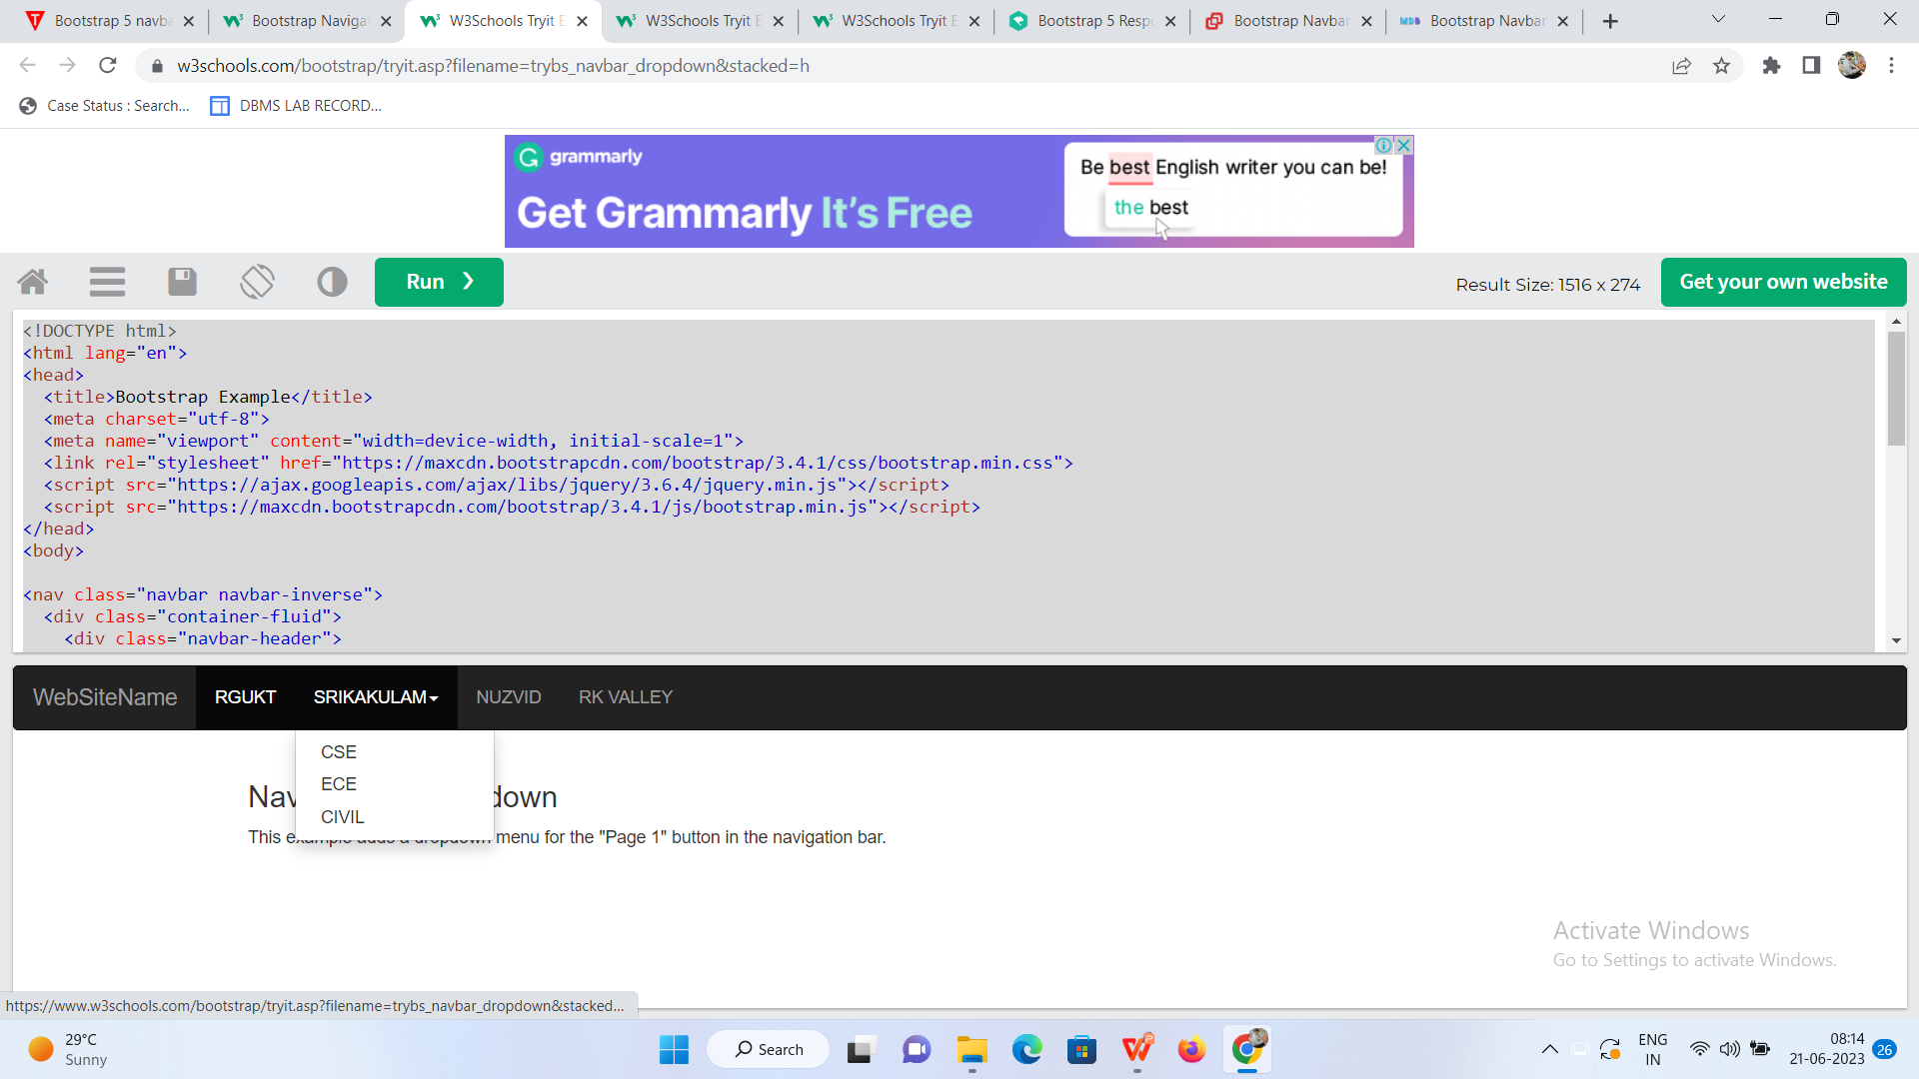

Slide 7
Navbar Buttons
To add buttons inside the navbar, add the .navbar-btn class on a Bootstrap button:
WebSiteName Home Link Link
BUTTON

Slide 8
<!DOCTYPE html>
<html lang="en">
<head>
<title>Bootstrap Example</title>
<meta charset="utf-8">
<meta name="viewport" content="width=device-width, initial-scale=1">
<link rel="stylesheet" href="https://maxcdn.bootstrapcdn.com/bootstrap/3.4.1/css/bootstrap.min.css">
<script src="https://ajax.googleapis.com/ajax/libs/jquery/3.6.4/jquery.min.js"></script>
<script src="https://maxcdn.bootstrapcdn.com/bootstrap/3.4.1/js/bootstrap.min.js"></script>
</head>
<body>
<nav class="navbar navbar-inverse">
<div class="container-fluid">
<div class="navbar-header">
<a class="navbar-brand" href="#">WebSiteName</a>
</div>
<ul class="nav navbar-nav">
<li class="active"><a href="#">Home</a></li>
<li><a href="#">Link</a></li>
<li><a href="#">Link</a></li>
</ul>
<button class="btn btn-danger navbar-btn">Button</button>
</div>
</nav>
<div class="container">
<h2>Navbar Button</h2>
<p>Use the navbar-btn class on a button to vertically align (same padding as links) it inside the navbar.</p>
</div>
</body>
</html>

Slide 9
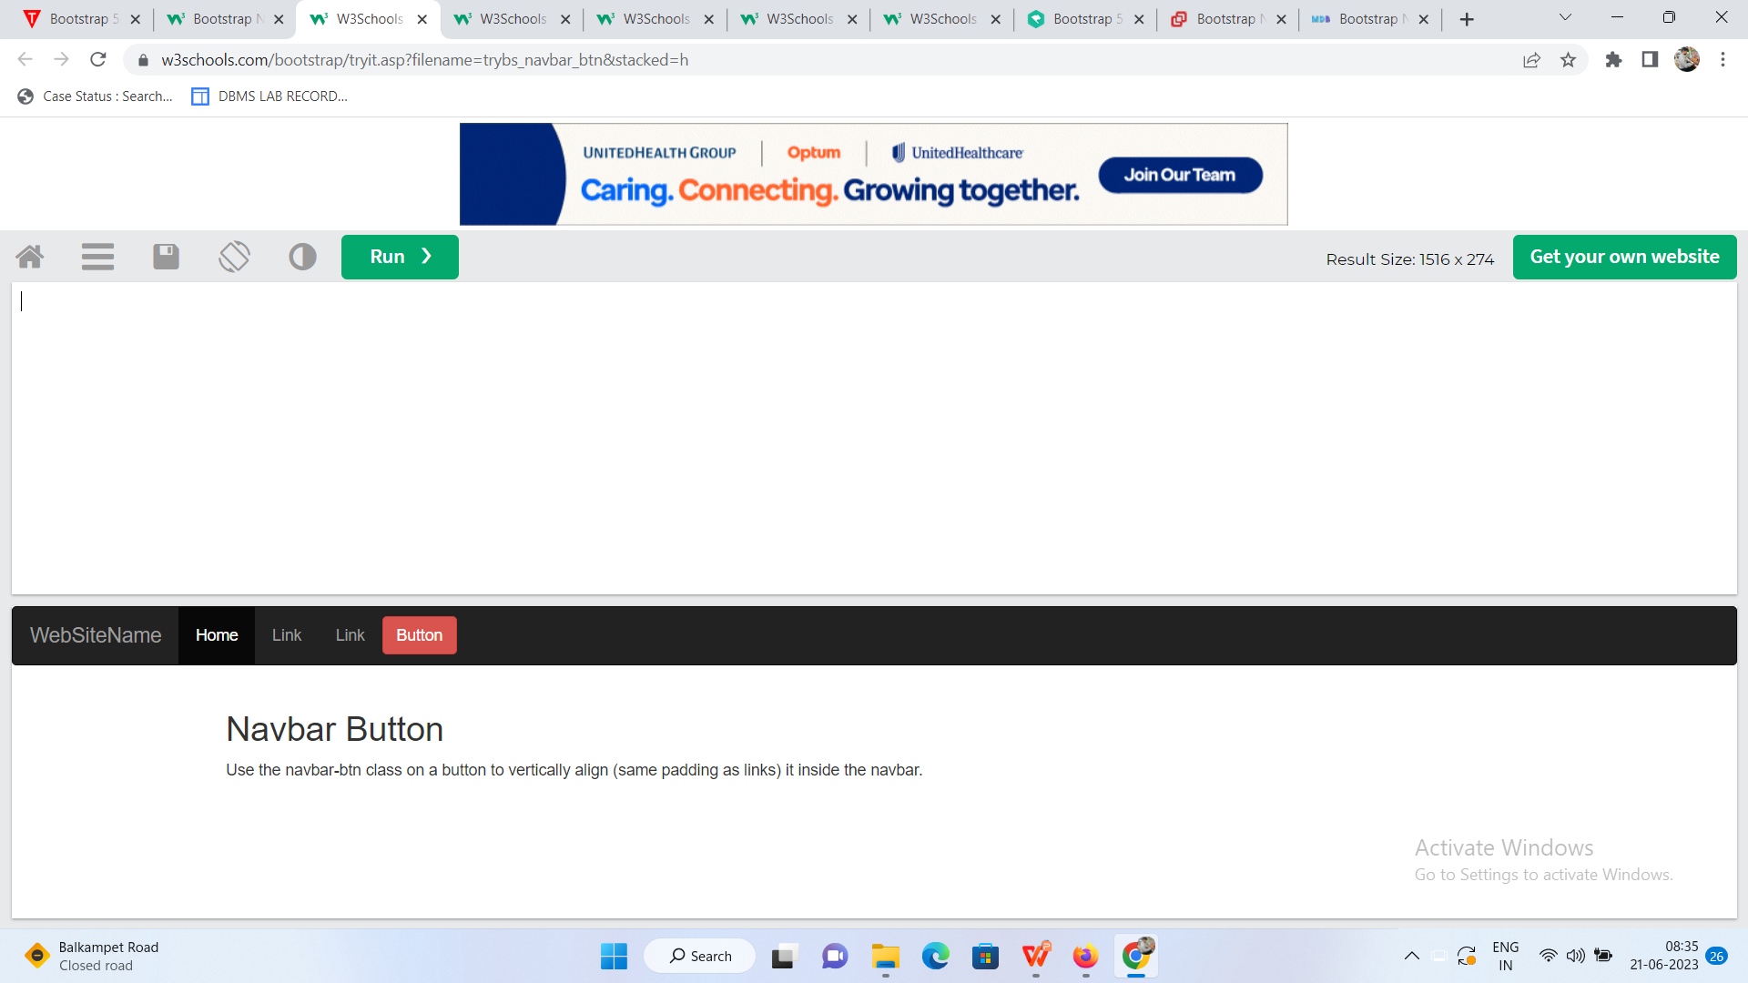

Slide 10
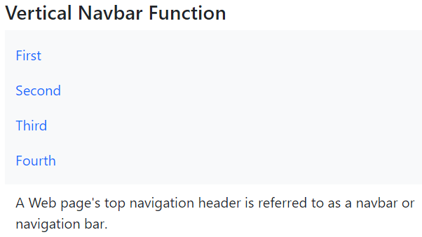
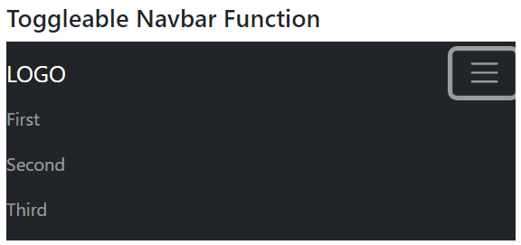
Test Yourself With Exercises
Navbar function with Logo
Centered navbar

